Slide 1
MPI、OpenMP并行编程
储根深
chugenshen@xs.ustb.edu.cn

Slide 2
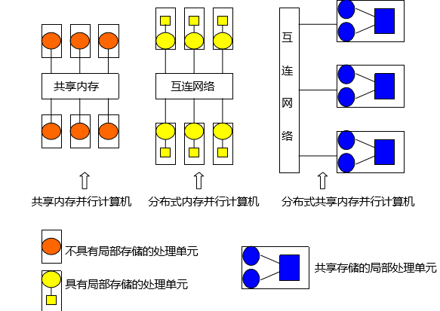
并行计算机分类(按存储方式)
预备知识
共享内存的并行计算机
分布内存的并行计算机
分布式共享内存的并行计算机
OpenMP标准是共享内存存储体系结构上的一个编程模型，是一种线程编程模型。
MPI:一种消息传递编程模型，用于分布式内存并行计算机(利用网络进行通信)，也可用于共享内存体系结构(一般利用共享内存进行通信)
Notes:
对于共享内存体系结构，MPI的实现通常不使用网络来进行任务间的通信。替代的办法是利用共享内存来进行通信，这样可以提高性能。

Slide 3
The History of MPI
MPI编程基础
Supercomputing 1992 conference defined a standard interface for performing message passing - the Message Passing Interface.
By 1994, a complete interface and standard was defined (MPI-1).
1997 MPI-2
September 21, 2012, MPI-3.0
September 2008,MPI-2.1
MPI-3.1 was approved by the MPI Forum on June 4, 2015.
MPI 4.0 in progress
MPI is a library , not a language.
MPI implementations：MPICH、CHIMP、Lam、impi
Notes:
MPI是根据MPI标准实现的库，它有不同的实现（但接口是一样的，意思是对我们使用者无区别）

Slide 4
MPI Hello World
MPI编程基础
#include <mpi.h> #include <stdio.h>
int main(int argc, char** argv) { // Initialize the MPI environment MPI_Init(NULL, NULL); // Get the number of processes int world_size, name_len, world_rank; MPI_Comm_size(MPI_COMM_WORLD, &world_size); // Get the rank of the process MPI_Comm_rank(MPI_COMM_WORLD, &world_rank); // Get the name of the processor char processor_name[MPI_MAX_PROCESSOR_NAME]; MPI_Get_processor_name(processor_name, &name_len); // Print off a hello world message printf("Hello world from processor %s, rank %d" " out of %d processors\n", processor_name, world_rank, world_size); // Finalize the MPI environment. MPI_Finalize(); return 0; }
MPI_Init(int *argc, char ***argv)
MPI_Finalize()
MPI_Comm_size(MPI_Comm communicator,int* size)
MPI_Comm_rank(MPI_Comm communicator,int* rank)
MPI_Get_processor_name( char* name, int* name_length)
MPI_COMM_WORLD

Slide 5
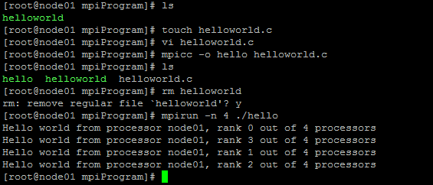
Run MPI Application
MPI编程基础
Compile
Advanced (Using Makefile)
mpicc -o hello hello_world.c
Run
EXECS=mpi_hello_world MPICC?=mpicc all: ${EXECS} mpi_hello_world: mpi_hello_world.c ${MPICC} -o mpi_hello_world mpi_hello_world.c clean: rm ${EXECS}
mpirun –n 4 ./hello
make mpicc -o hello_world hello_world.c
Notes:
这是在一个机器上的情况

Slide 6
MPI Send and Receive
MPI编程基础
Elementary MPI datatypes
MPI_Send(
void* data,
int count,
MPI_Datatype datatype,
int destination,
int tag,
MPI_Comm communicator)
MPI datatype | C equivalent
MPI_SHORT | short
MPI_INT | int
MPI_LONG | long
MPI_LONG_LONG | long long
MPI_UNSIGNED_CHAR | unsigned char
MPI_UNSIGNED_SHORT | unsigned short
MPI_UNSIGNED | unsigned int
MPI_UNSIGNED_LONG | unsigned long
MPI_UNSIGNED_LONG_LONG | unsigned long long
MPI_FLOAT | float
MPI_DOUBLE | double
MPI_LONG_DOUBLE | long double
MPI_BYTE | char
MPI_Recv( void* data, int count, MPI_Datatype datatype, int source, int tag, MPI_Comm communicator, MPI_Status* status)
MPI_Isend()
MPI_Irecv()

Slide 7
Message Example
MPI编程基础
#include <mpi.h> #include <stdio.h> #include <stdlib.h> int main(int argc, char** argv) { // Initialize the MPI environment MPI_Init(NULL, NULL); // Find out rank, size int world_rank, world_size; MPI_Comm_rank(MPI_COMM_WORLD, &world_rank); MPI_Comm_size(MPI_COMM_WORLD, &world_size); // We are assuming at least 2 processes for this task if (world_size < 2) { printf(stderr, "World size must be greater than 1 for %s\n", argv[0]); MPI_Abort(MPI_COMM_WORLD, 1); } int number; if (world_rank == 0) { // If we are rank 0, set the number to -1 and send it to process 1 number = -1; MPI_Send(&number, 1, MPI_INT, 1, 0, MPI_COMM_WORLD); } else if (world_rank == 1) { MPI_Recv(&number, 1, MPI_INT, 0, 0, MPI_COMM_WORLD, MPI_STATUS_IGNORE); printf("Process 1 received number %d from process 0\n", number); } MPI_Finalize(); }
mpirun -n 2 ./send_recv
Process 1 received number -1 from process 0

Slide 8
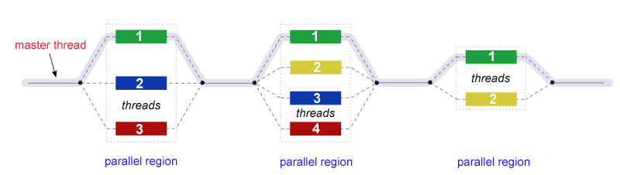
OpenMP Programming Model
OpenMP
OpenMP（Open Multi-Processing）

Slide 9
OpenMP Compilers
OpenMP
Compiler support
Vendor/Source | Compiler | Information
Open Source | GCC | Free and open source – Linux, Solaris, AIX, MacOSX, Windows, FreeBSD, NetBSD, OpenBSD, DragonFly BSD, HPUX, RTEMS From GCC 4.2.0, OpenMP 2.5 is fully supported. From GCC 4.4.0, OpenMP 3.0 is fully supported. From GCC 4.7.0, OpenMP 3.1 is fully supported. In GCC 4.9.0, OpenMP 4.0 is supported for C and C++, but not Fortran. From GCC 4.9.1, OpenMP 4.0 is fully supported. From GCC 6.1, OpenMP 4.5 is fully supported for C and C++. Compile with -fopenmp to enable OpenMP. Online documentation: https://gcc.gnu.org/onlinedocs/libgomp/ OpenMP support history: https://gcc.gnu.org/projects/gomp/
Some other compilers:
IBM: XL C/C++ / Fortran
Oracle: C/C++ / Fortran
Intel：C/C++ / Fortran
…
Notes:
Linux 上不需要安装环境

Slide 10
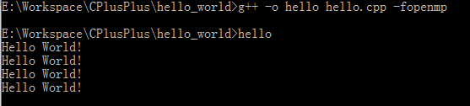
OpenMP Hello World
OpenMP
#include <omp.h> #include <iostream> using namespace std; int main(int argc, char **argv) { #pragma omp parallel cout << "Hello World!" << endl; return 0; }
Run OpenMP on windows with C++
Compile: g++ -o hello hello.cpp -fopenmp
Notes:
Linux 上不需要安装环境

Slide 11
Compiler Directive
OpenMP
Control number of threads:
num_threads(3)
omp_set_num_threads(5); //call a function
#include <omp.h> #include <iostream> using namespace std; int main(int argc, char **argv) { #pragma omp parallel num_threads(3) { cout << "Hello World!\n"; } return 0; }
parallel for
#include <omp.h> #include <iostream> using namespace std; int main() { int a[1000000], b[1000000]; // ... some initialization code for populating arrays a and b; int c[1000000]; #pragma omp parallel for for (int i = 0; i < 1000000; ++i){ c[i] = a[i] * b[i] + a[i - 1] * b[i + 1]; } // ... now do some processing with array c }
num_threads
omp_get_thread_num();
//get thread id
example of “parallel for”
Notes:
For ：http://blog.csdn.net/zsc09_leaf/article/details/7754135

Slide 12
Compiler Directive
OpenMP
Control number of threads:
num_threads(3)
omp_set_num_threads(5); //call a function
#include <omp.h> #include <iostream> using namespace std; int main(int argc, char **argv) { #pragma omp parallel num_threads(3) { cout << "Hello World!\n"; } return 0; }
parallel for
#include <omp.h> #include <iostream> using namespace std; int main() { int a[1000000], b[1000000]; // ... some initialization code for populating arrays a and b; int c[1000000]; #pragma omp parallel for for (int i = 0; i < 1000000; ++i){ c[i] = a[i] * b[i] + a[i - 1] * b[i + 1]; } // ... now do some processing with array c }
num_threads
omp_get_thread_num();
//get thread id
example of “parallel for”
Notes:
For ：http://blog.csdn.net/zsc09_leaf/article/details/7754135
for(i=0;i<10000;i++){ a[i] = a[i-1]+1; }//不可以并行化

Slide 13
Compiler Directive
OpenMP
#include <omp.h> main(int argc, char *argv[]) { int i, n, chunk; float a[100], b[100], result; /* Some initializations */ n = 100; chunk = 10; result = 0.0; for (i=0; i < n; i++) { a[i] = i * 1.0; b[i] = i * 2.0; } #pragma omp parallel for \ default(shared) private(i) \ schedule(static,chunk) \ reduction(+:result) for (i=0; i < n; i++) result = result + (a[i] * b[i]); printf("Final result= %f\n",result); }
private() | The private clause declares variables in its list to be private to each thread.
shared() | The shared clause declares variables in its list to be shared among all threads in the team.
reduction() | The reduction clause performs a reduction on the variables that appear in its list.
default() | The default clause allows the user to specify a default scope for all variables in the lexical extent of any parallel region
https://computing.llnl.gov/tutorials/openMP
Notes:
For ：http://blog.csdn.net/zsc09_leaf/article/details/7754135
for(i=0;i<10000;i++){ a[i] = a[i-1]+1; }//不可以并行化

Slide 14
Git
gdb
makefile

